Slide 1
Programming for Internet of Things
Object classification and IoT Grocery Sync
Alyana Nelson
Ramprakash Sridharan

Slide 2
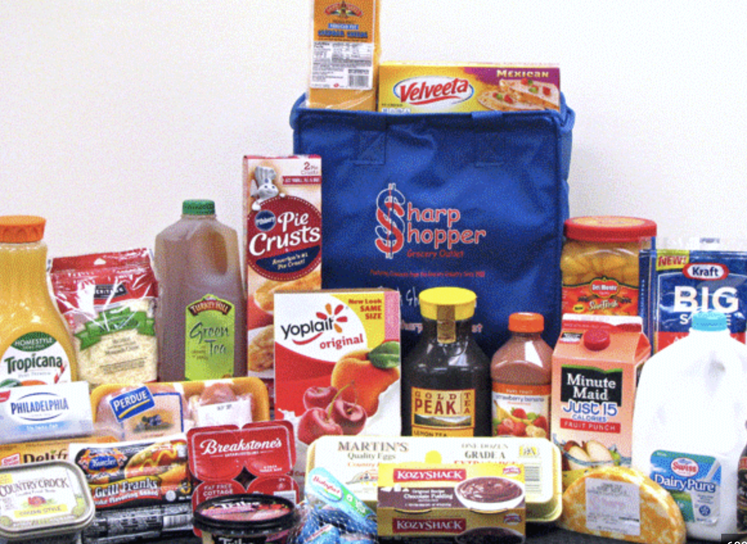
Task/Problem
A kitchen-based system that allows you to effortlessly add items to your grocery list.
Simply show the food product to the camera, and it will automatically update your 'grocery cart'. such as an Apples, water, yogurt, cereal, oil, etc.

Slide 3
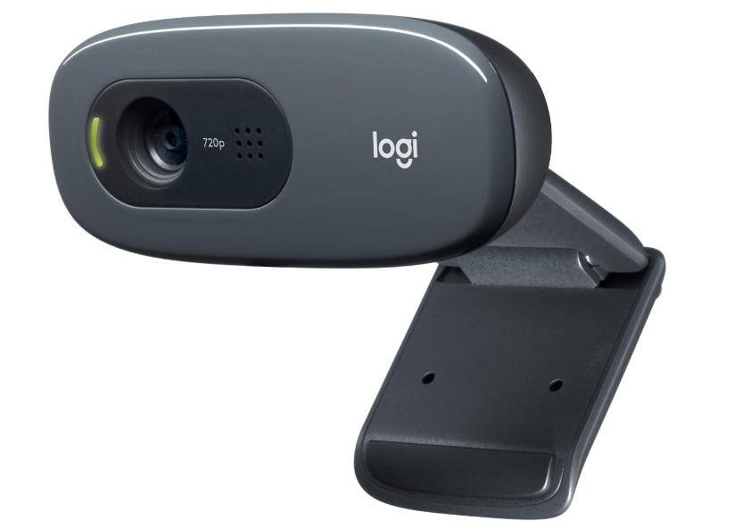
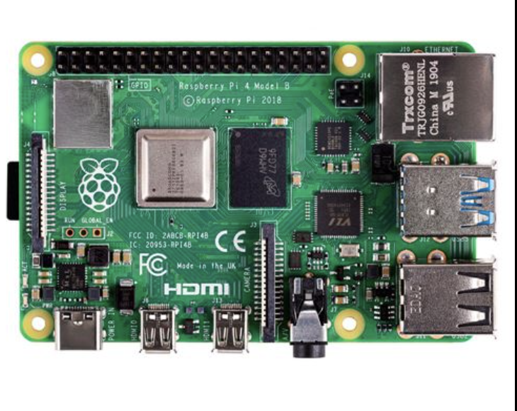
Components of the system
Hardware Components:
Raspberry Pi 4B
Webcam
Software Components:
Yolov5 - Deep learning model for object tracking and classification.
Node server.
Webpage to track the grocery list .

Slide 4
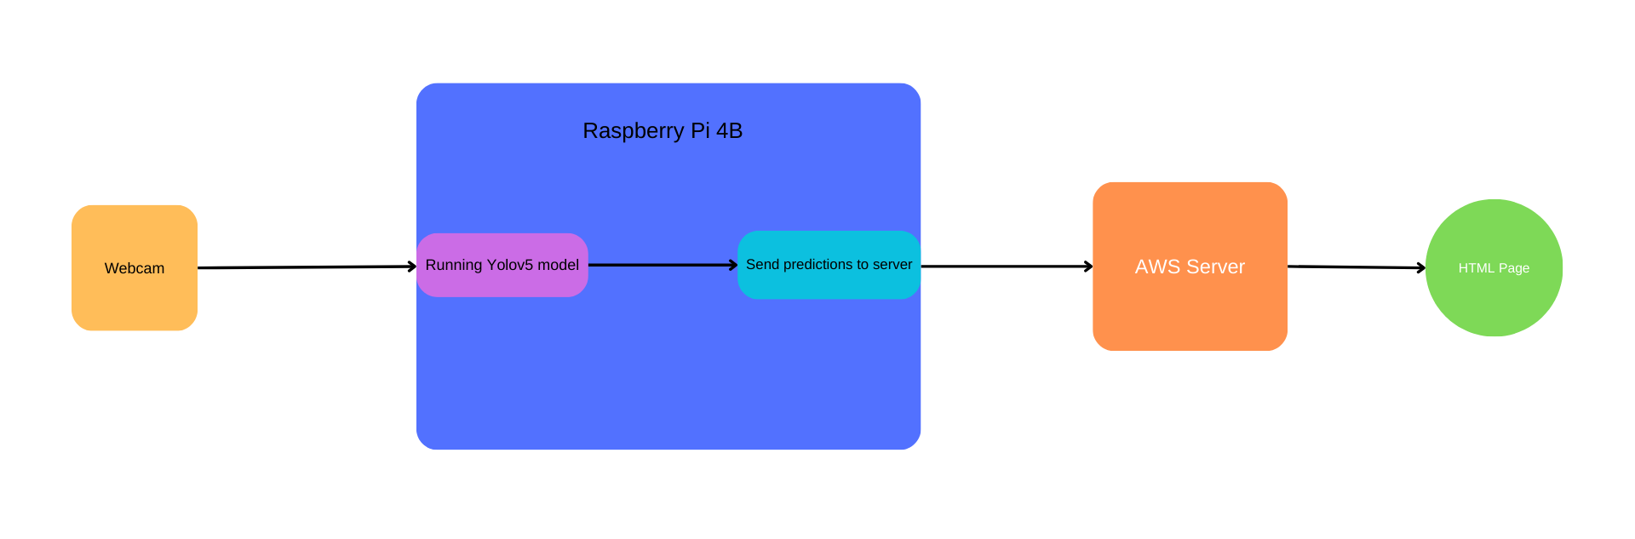
Interactions

Slide 5
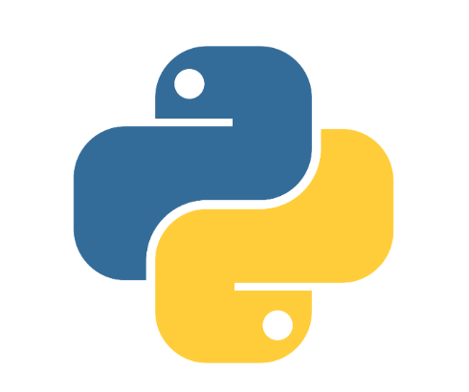

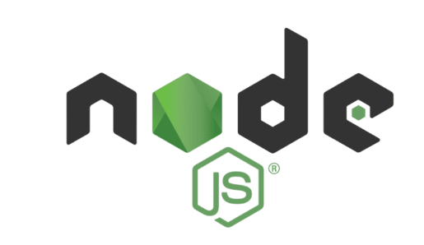
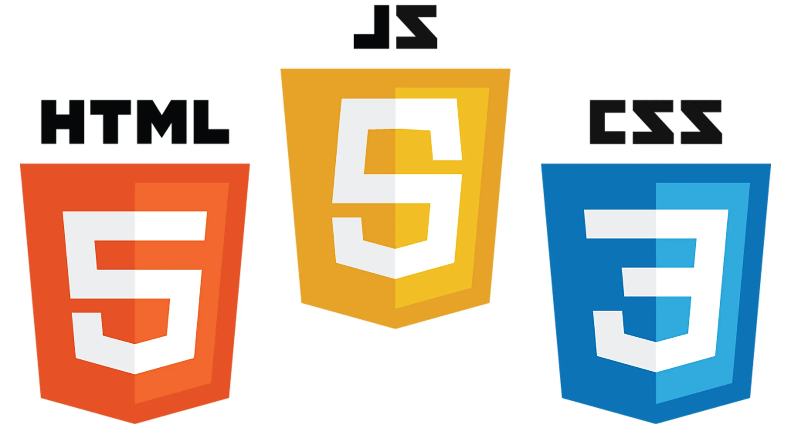
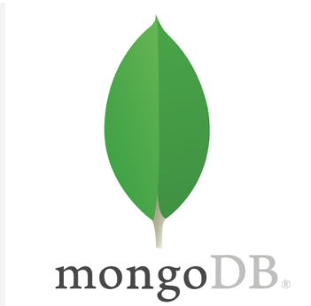
Tech stack
Python
Pytorch
Node js
Javascript, HTML, CSS
MongoDB

Slide 6
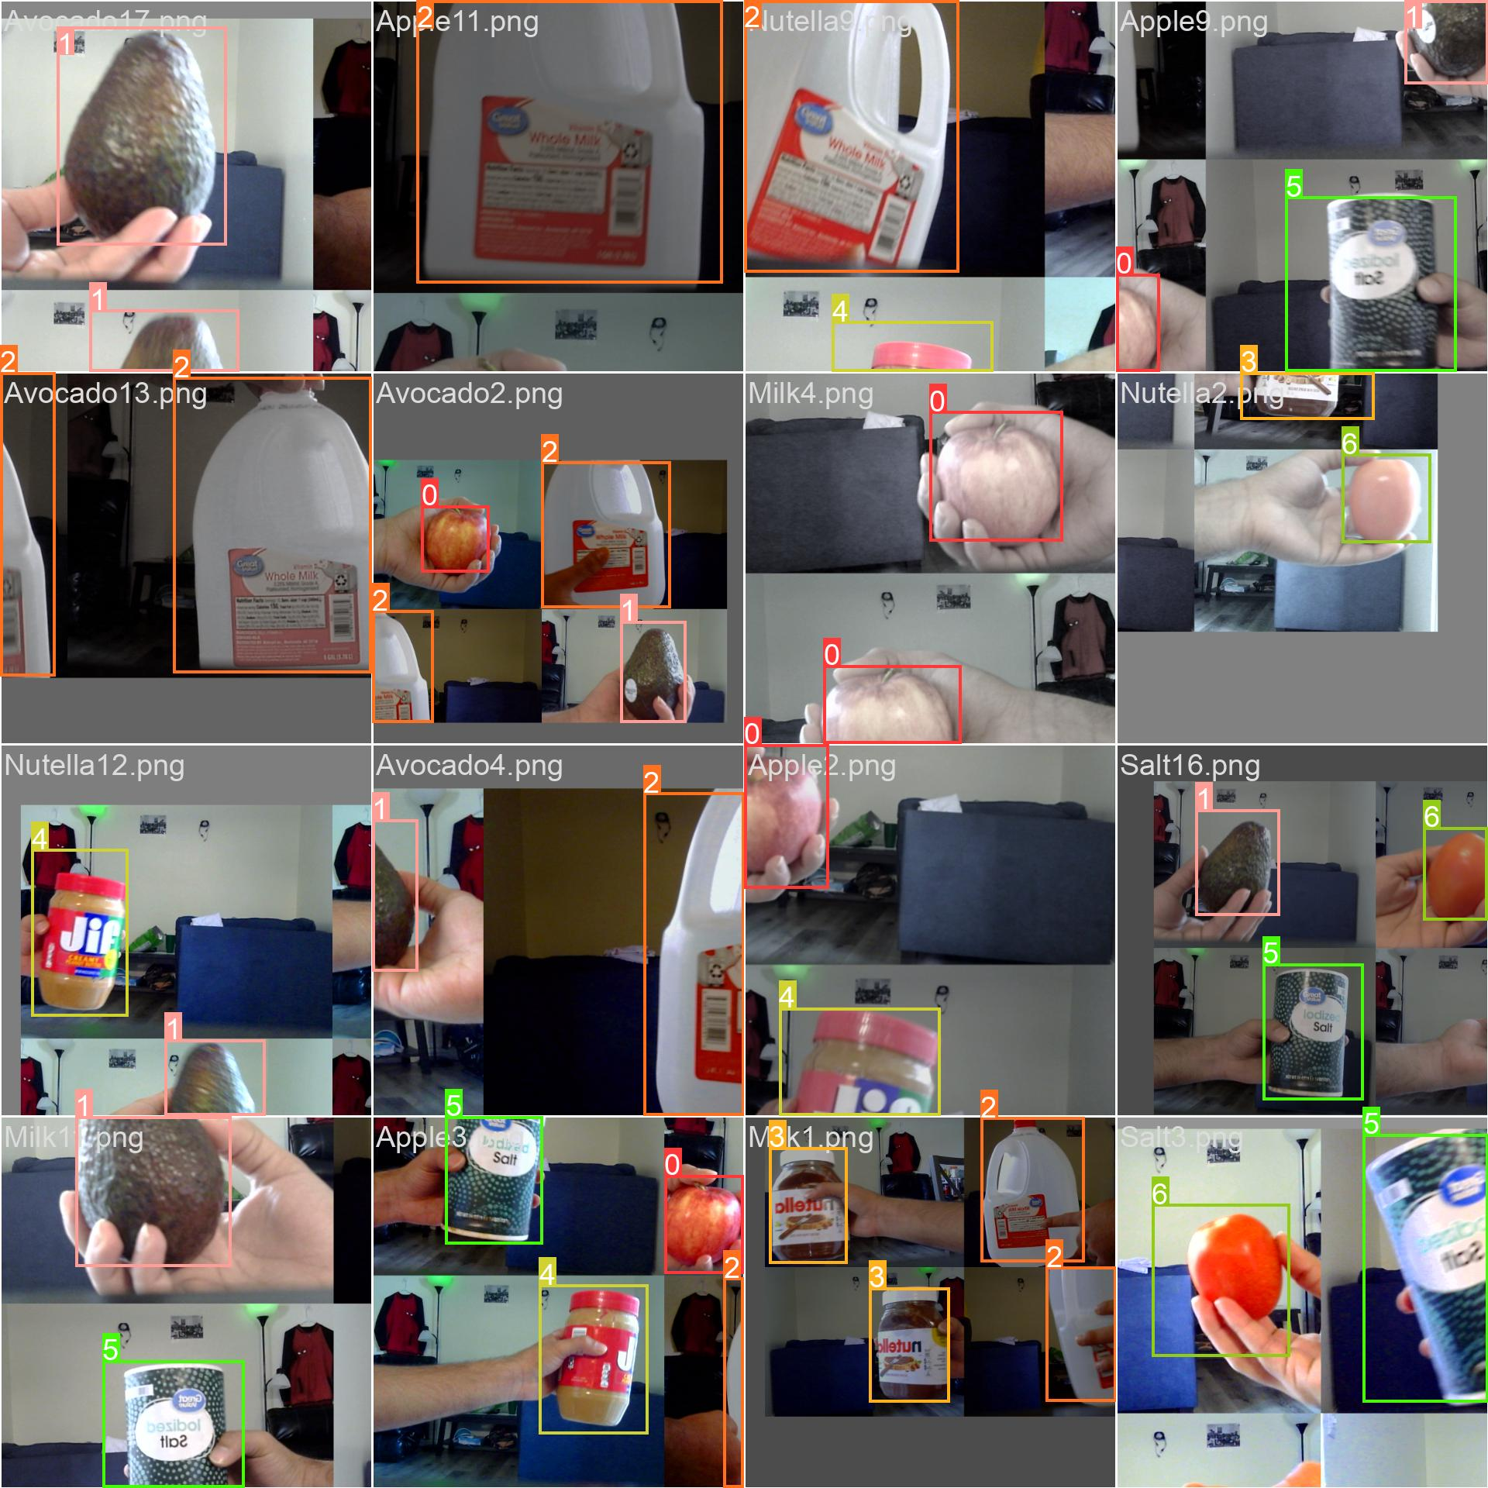
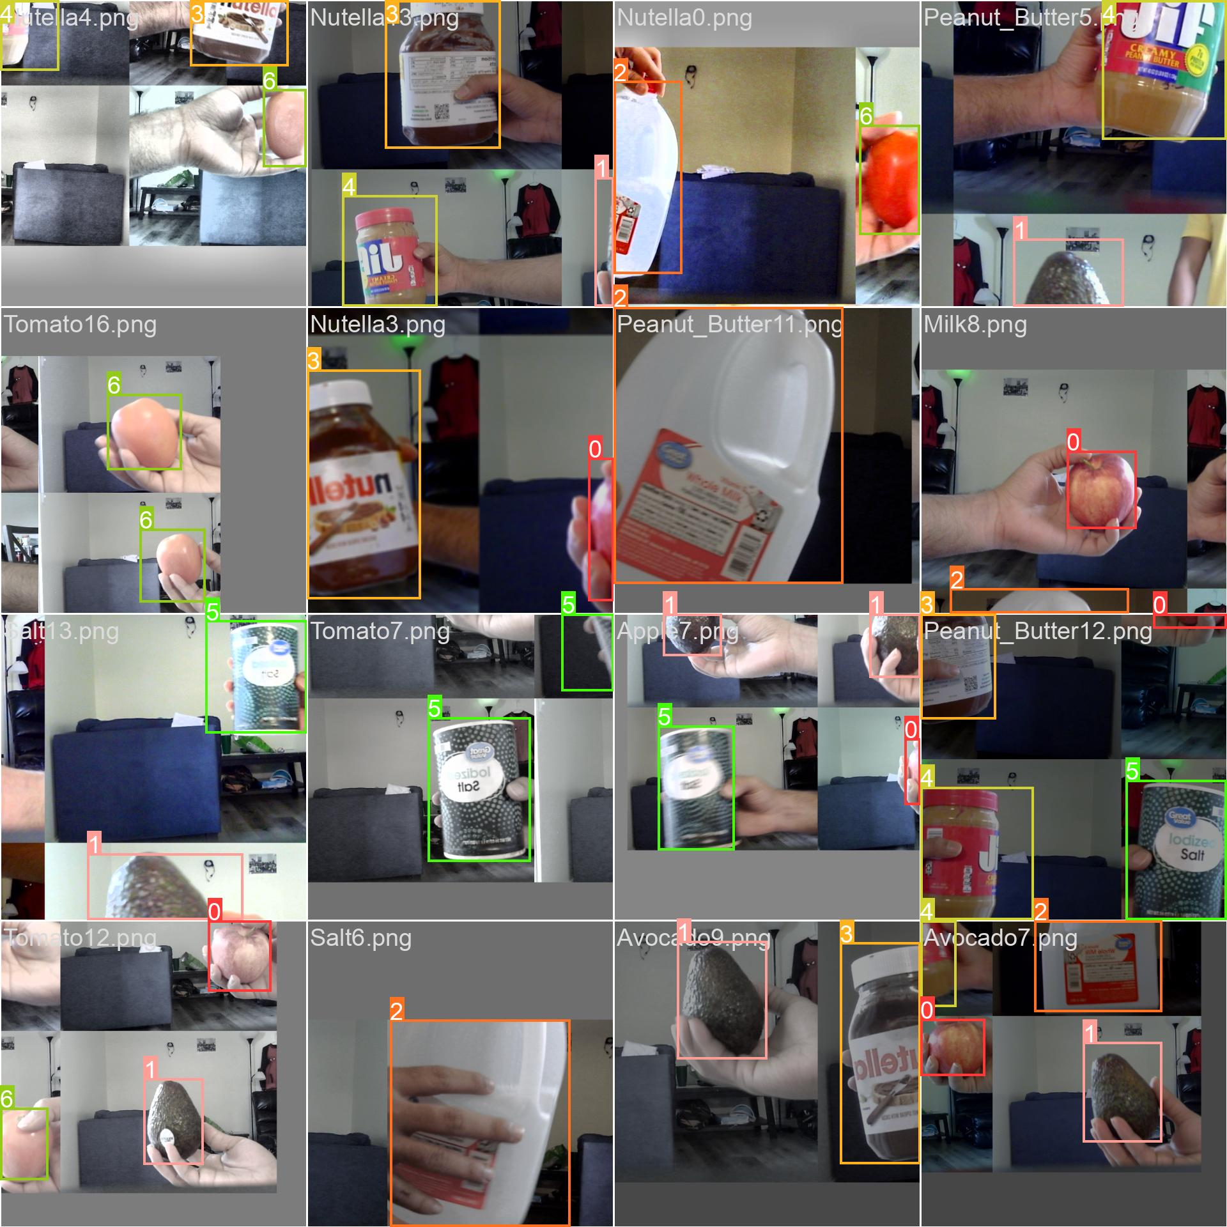
Model training
The training images used for the model are shown below. The images are subjected to morphological operations (shear, zoom, mosaic) etc and fed into the model.
The dataset consists of 20 images for each class with a total of 140 images.

Slide 7
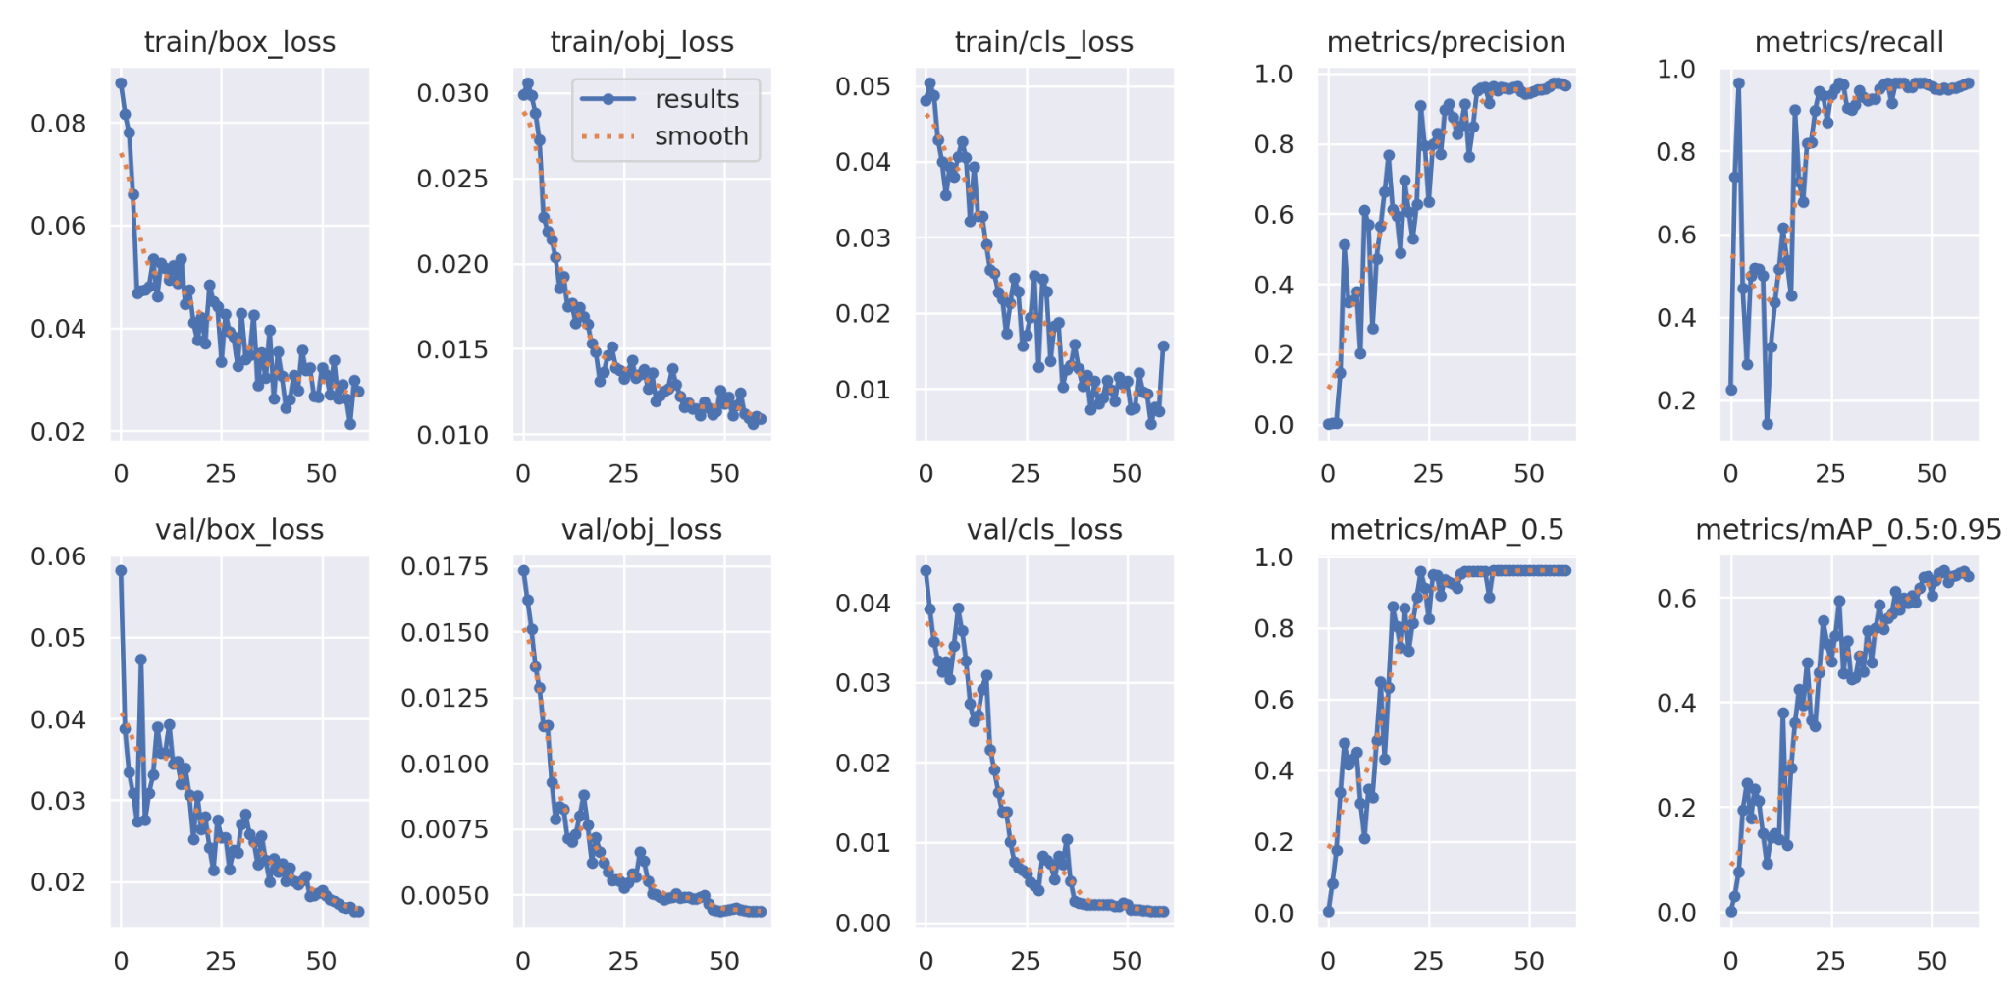
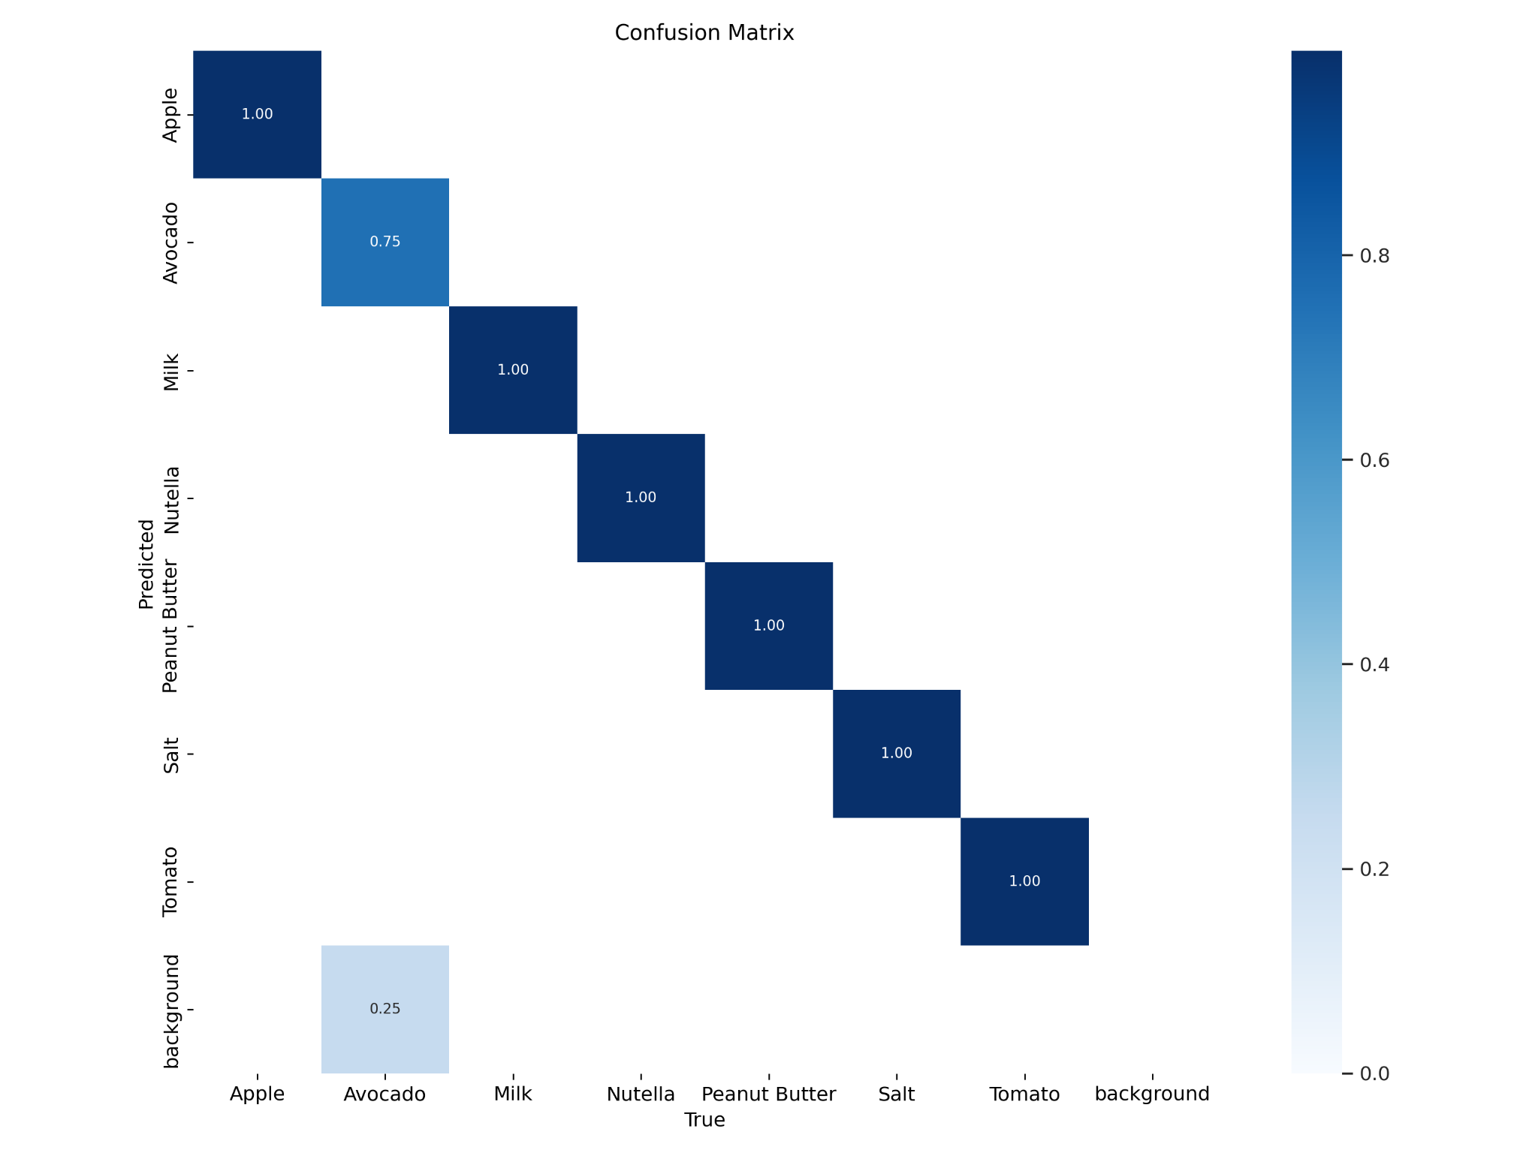
Training Result
The model is trained for 50 epochs
The confusion matrix and the loss graphs are shown above.

Slide 8
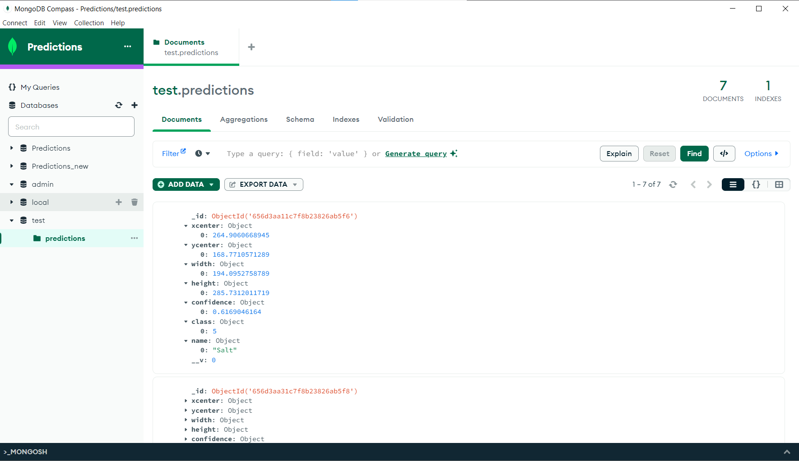
Model deployment
The trained model is deployed to AWS server and MongoDB is used to handle the data.
Mongoose library is used to add data to the database.

Slide 9
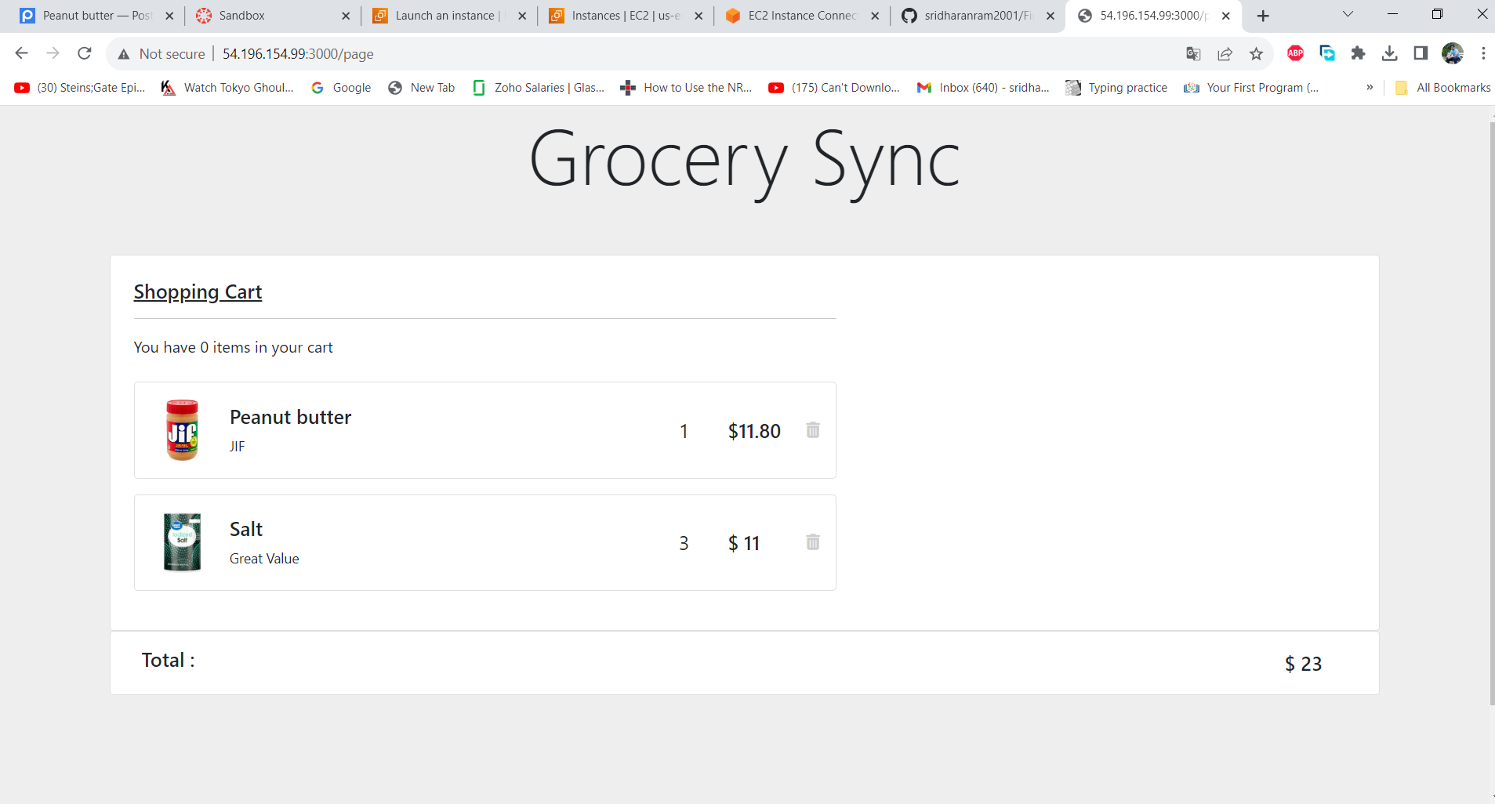
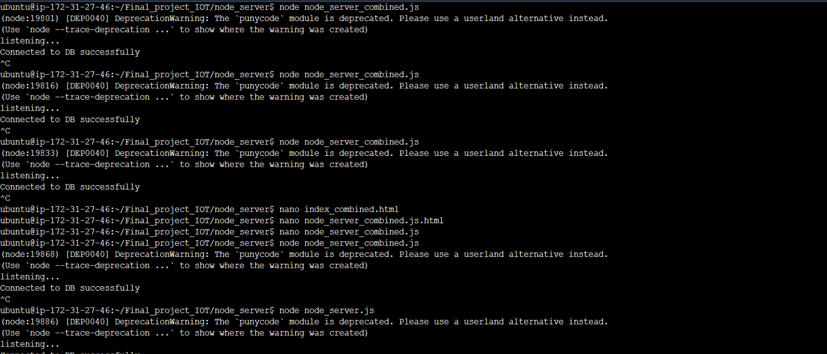
Final Result

Slide 10
Challenges
The Deep learning model is not properly optimized for all classes , but good enough detection accuracy for this application.
The model is not deployed in Raspberry Pi 4 but when deployed would work the same as in the computer.
The HTML page is hosted as a single file using res.sendFile() from the node server. The js files and style files had to put in the same file to make it work.
One other way is to use ejs to render the file.
The database query operations such were hard to perform as a beginner.

Slide 11
THANK YOU

